Slide 1

Recruitment Toolkit for College Youth

Slide 2
Purpose
Using the MRC-STTRONG Grant, MRCIL aims to support local MRCs by providing two digital toolkits. These toolkits will focus on two main audiences: college students and healthcare professionals.
The initiative is designed to assist MRC Coordinators in recruiting younger individuals and licensed healthcare professionals (includes those in medicine, dentistry, veterinary medicine, allied health, and behavioral health).
The toolkits will include a variety of resources, including MRC FAQs, social media posts, email templates, and more.

Slide 3

College Digital Toolkit

Slide 4
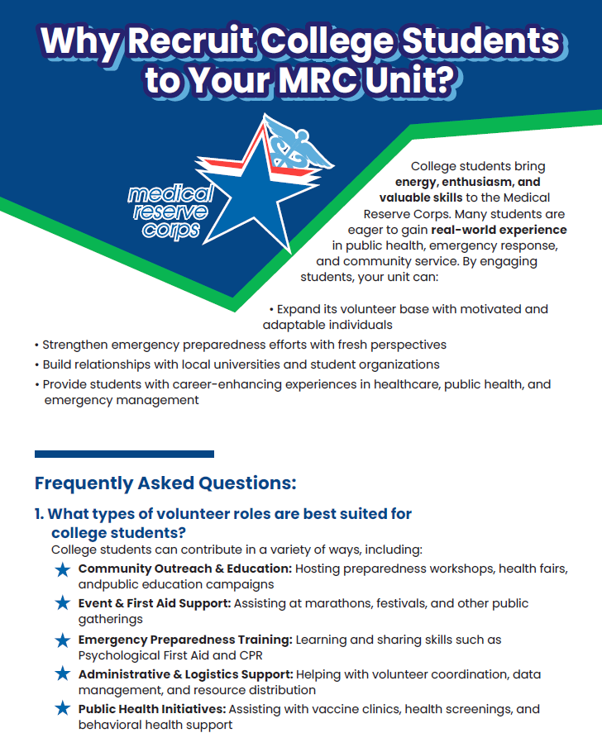
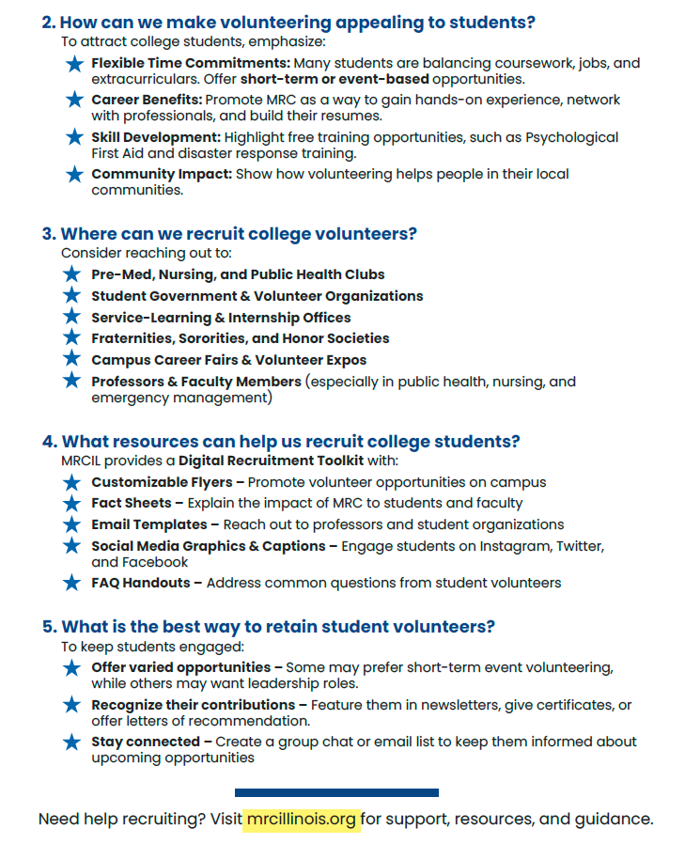
Why Recruit College Students?

Slide 5
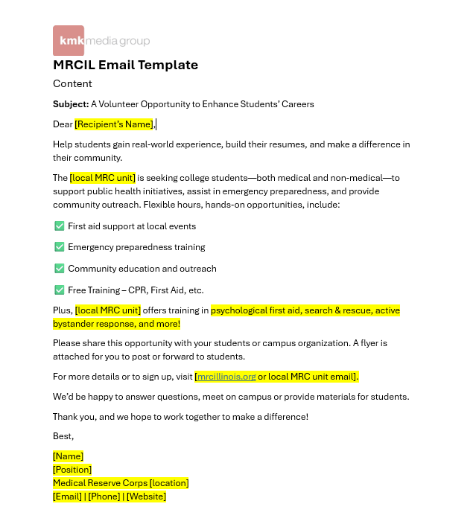
Email Template

Slide 6
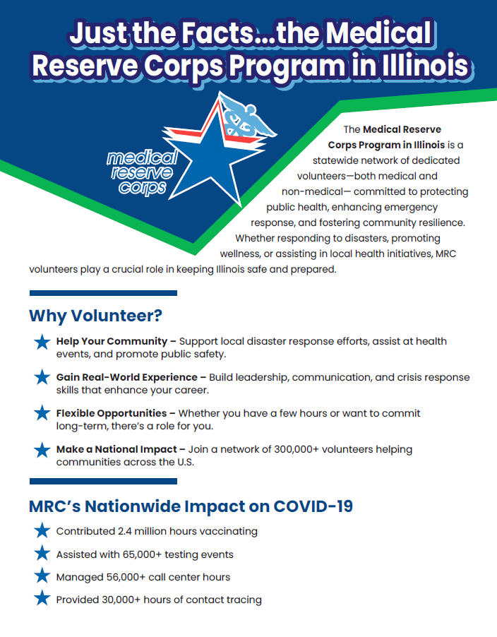
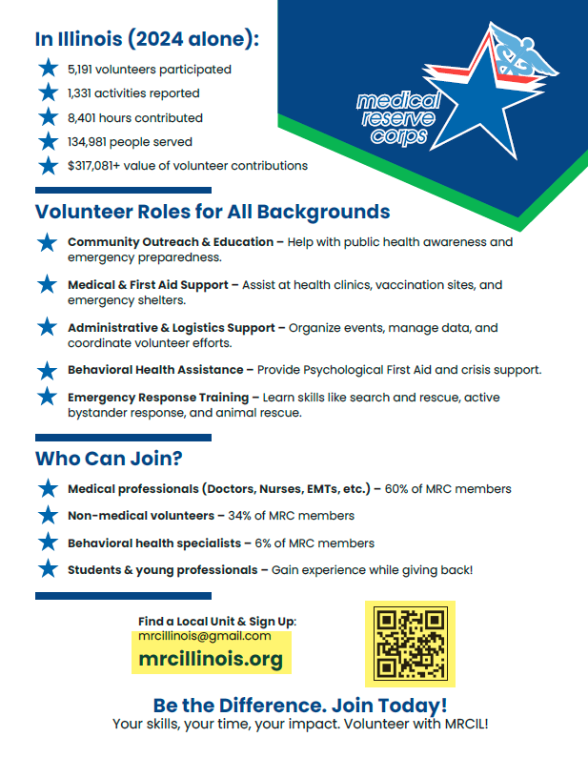
Just the Facts – MRC Program in Illinois

Slide 7
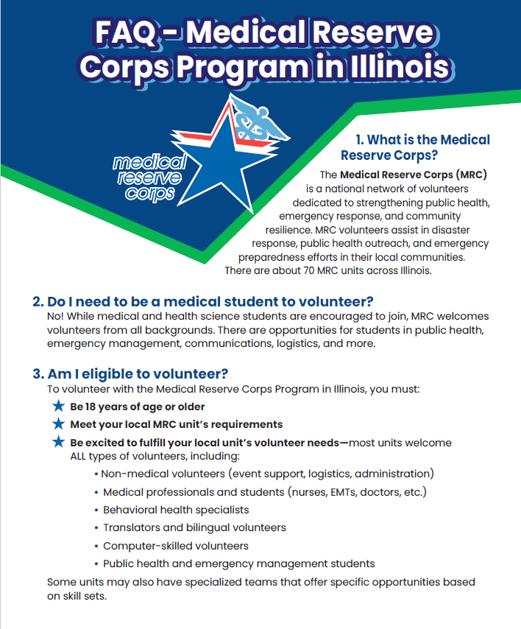
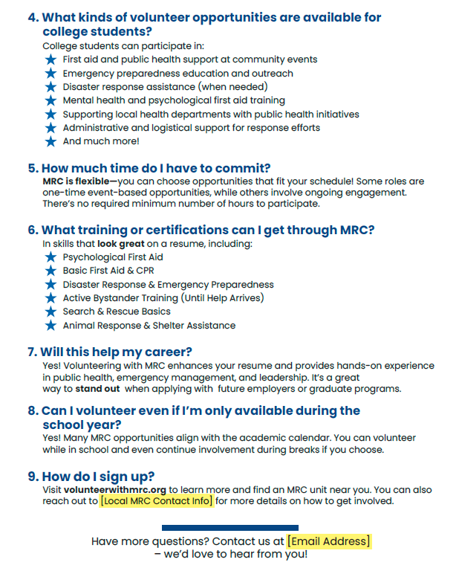
FAQ – MRC Program in Illinois

Slide 8
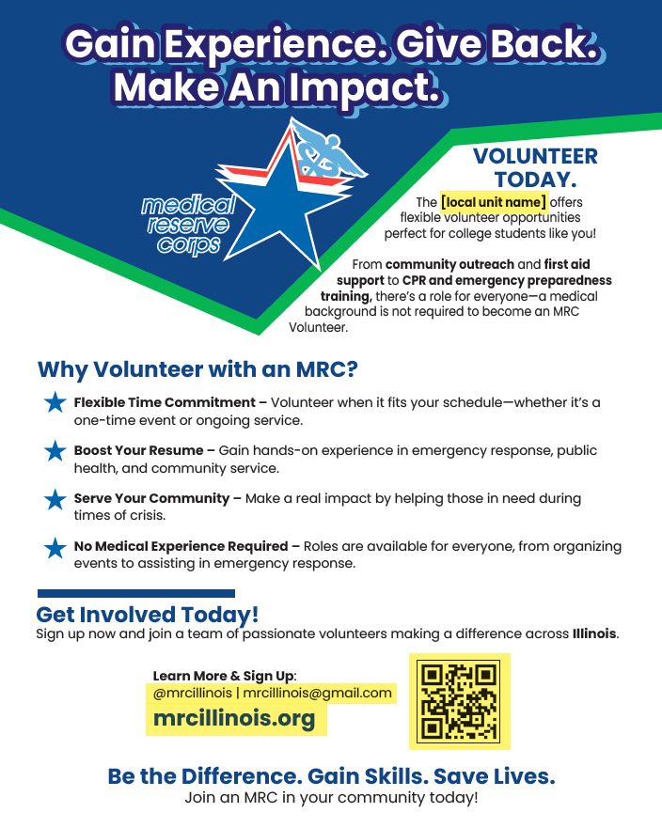
MRC Flyer

Slide 9
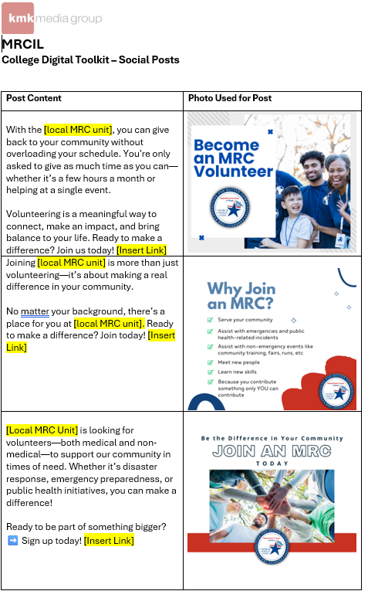
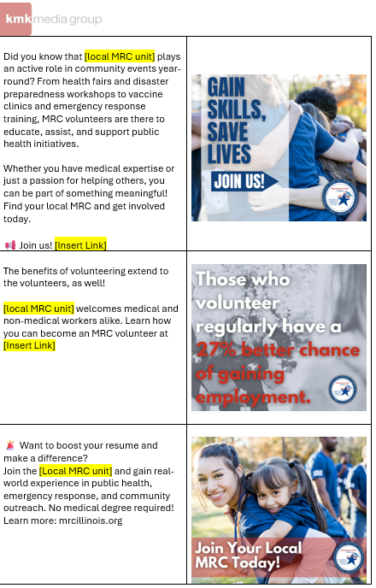
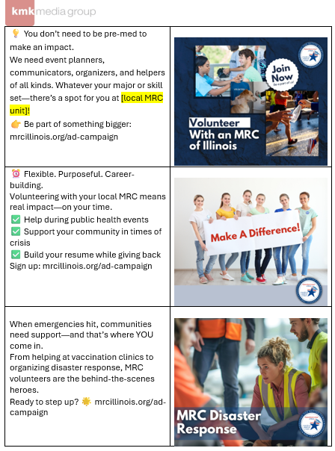
Social Media Posts

Slide 10

Stay Tuned for the Healthcare Digital Toolkit!

